Slide 1
Task-6: Bank Loan Case Study

Slide 2
Excel Tasks:
Contents:
Project Description
Tech Stack Used
Approach
Insights
Results and Conclusion
Identify Missing Data and Deal with it Appropriately
Identify Outliers in the Dataset
Analyse Data Imbalance
Perform Univariate, Segmented Univariate, and Bivariate Analysis
Identify Top Correlations for Different Scenarios

Slide 3
Project Description:
The Bank Loan Case Study project, My aim is to use Exploratory Data Analysis (EDA) to analyze patterns in the data and ensure that capable applicants are not rejected.
My task is to use Exploratory Data Analysis (EDA) to analyze patterns in the data and ensure that capable applicants are not rejected.
Through in-depth data analysis using Excel, Data Visualization and Statistics techniques this project seeks to extract valuable insights and to identify patterns that indicate if a customer will have difficulty paying their installments.
Software Used: Microsoft Excel 365
NOTE: ALL THE LINKS FOR CLEANED DATASET AND SOLUTIONS DATASET ARE PROVIDED BELOW !!!

Slide 4
My Approach:
DATA HANDLING
I have gone through the dataset and understood all the given columns. Then I have observed that there are a total of 128 Columns and 49999 Rows. This dataset consists of unwanted columns, Null values and Blank rows. So, I have decided to Clean this dataset thoroughly.
Full Results Dataset: https://docs.google.com/spreadsheets/d/1mAHEXTZ_rjQ5VJXV3DHep1SJhlErK55p/edit?usp=sharing&ouid=113249253121491889461&rtpof=true&sd=true

Slide 5
1) Identify Missing Data and Deal with it Appropriately
DATA ANALYSIS
As a data analyst, you come across missing data in the loan application dataset.
It is essential to handle missing data effectively to ensure the accuracy of the analysis.
Task: Identify the missing data in the dataset and decide on an appropriate method
to deal with it using Excel built-in functions and features.
FUNTIONS I HAVE USED:
LINK FOR THE PROJECT
=COUNTBLANK(A2:A50000)
=COUNTBLANK(A2:A50000)/COUNTA(A2:A50000)*100
Firstly, after calculating the Null Values I have deleted the columns which has the null values percentage greater than 25%. Then I have replaced the null values with the median for the columns which has null values less than 25%
=MEDIAN(J2:J50000)
By the end, I left with total of 72 Columns and 49999 Rows.
Thus, In this Task, I learned to handle missing values in a large dataset.

Slide 6
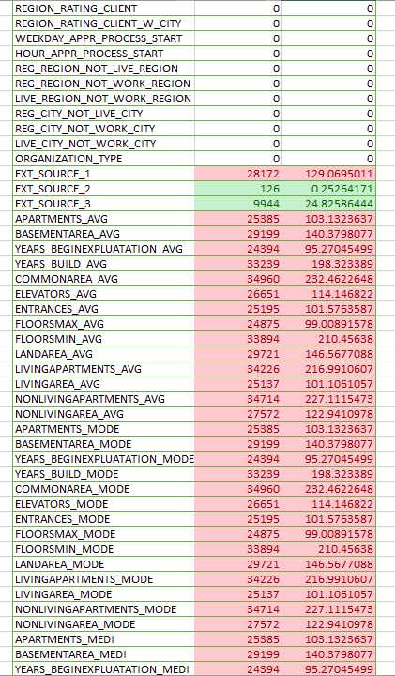
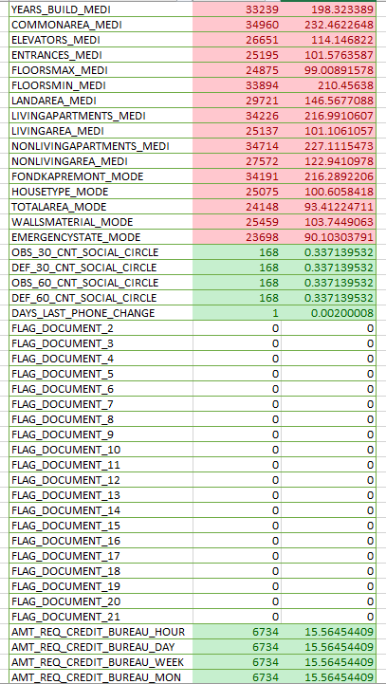
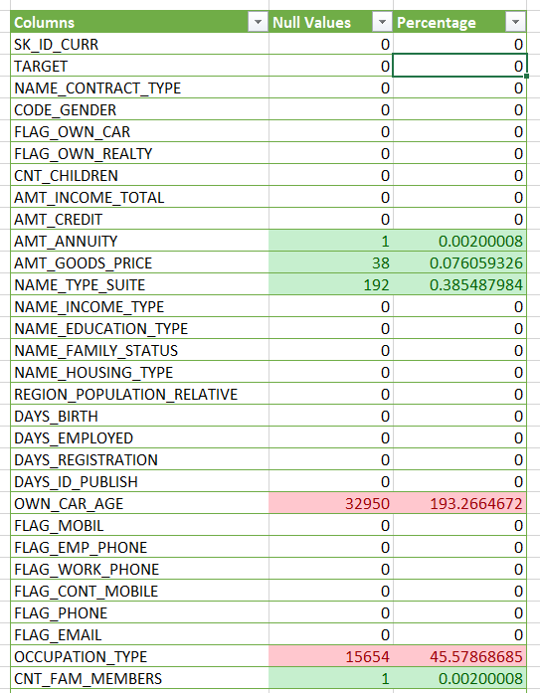
1) Identify Missing Data and Deal with it Appropriately
DATA ANALYSIS
Results: Before Cleaning

Slide 7
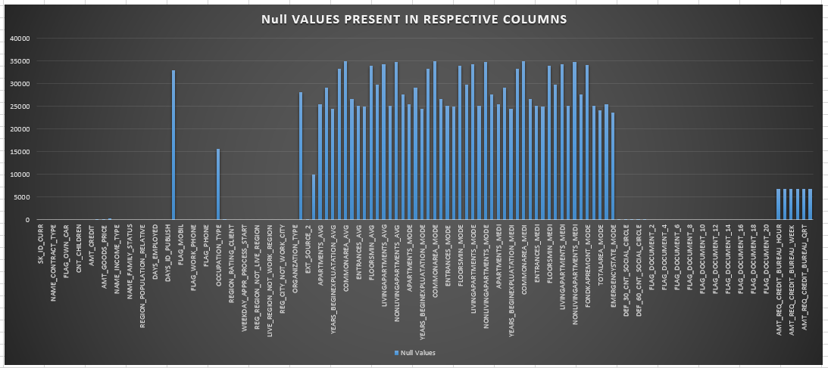
1) Identify Missing Data and Deal with it Appropriately
DATA ANALYSIS
Results: Before Cleaning

Slide 8
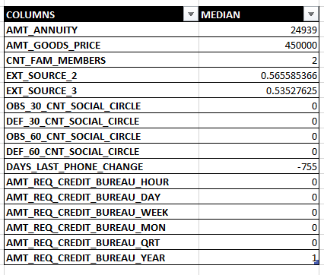
1) Identify Missing Data and Deal with it Appropriately
DATA ANALYSIS
Results: After Cleaning
I have used these values to replace the null values in the columns which has null values less than 25%.
For text based columns I used the mode function and replaced the null values with the most repeated text.

Slide 9
2) Identify Outliers in the Dataset:
DATA ANALYSIS
Outliers can significantly impact the analysis and distort the results. You need to
identify outliers in the loan application dataset.
Task: Detect and identify outliers in the dataset using Excel statistical functions
and features, focusing on numerical variables.
Functions I have Used:
LINK FOR THE PROJECT
=QUARTILE.EXC(A2:A50000,1) [QUARTILE-1]
=QUARTILE.EXC(A2:A50000,3) [QUARTILE-3]
=O10-O9 [IQR]
=O9-(1.5*O11) [LOWER BOUND]
=O10+(1.5*O11) [UPPER BOUND]
By using these functions, I have Calculated Quartile-1, Quartile-2, Inter Quartile Range (IQR), Lower Bound, Upper Bound.

Slide 10
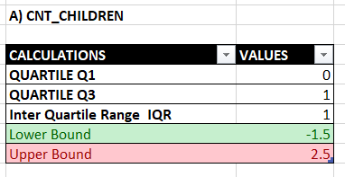
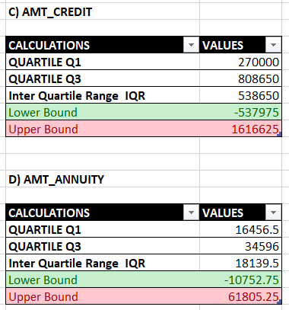
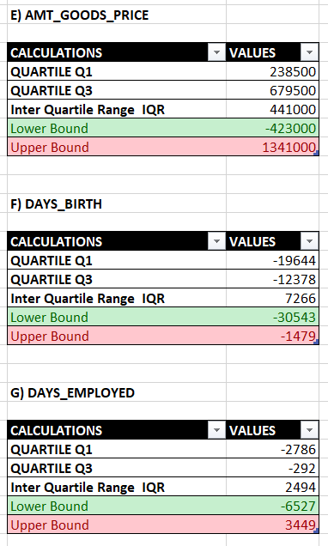
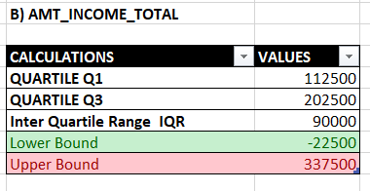
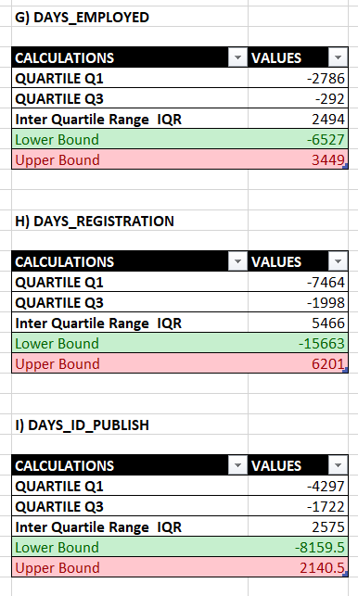
2) Identify Outliers in the Dataset:
DATA ANALYSIS
Results:

Slide 11
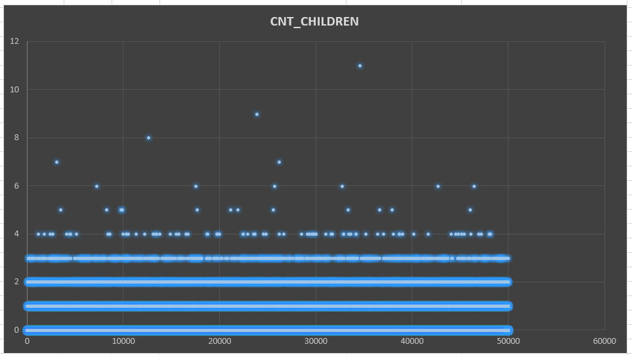
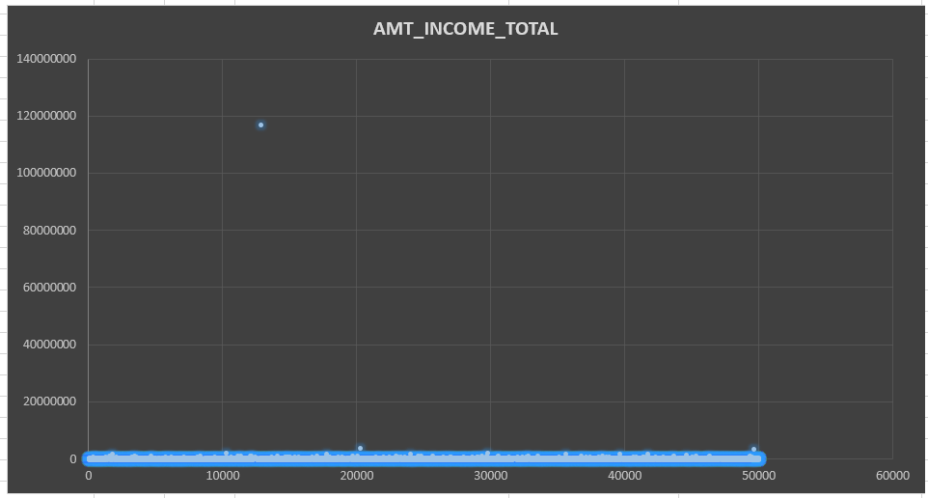
2) Identify Outliers in the Dataset:
DATA ANALYSIS
Results:

Slide 12
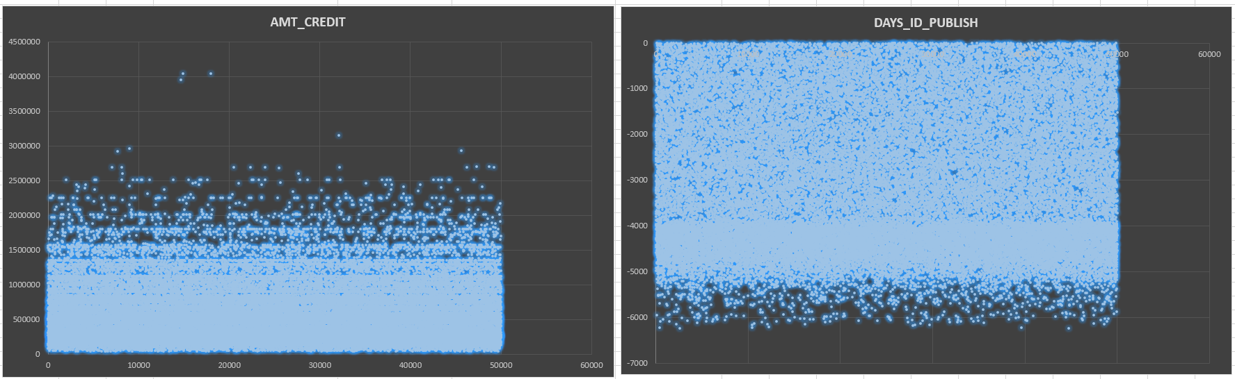
2) Identify Outliers in the Dataset:
DATA ANALYSIS
Results:

Slide 13
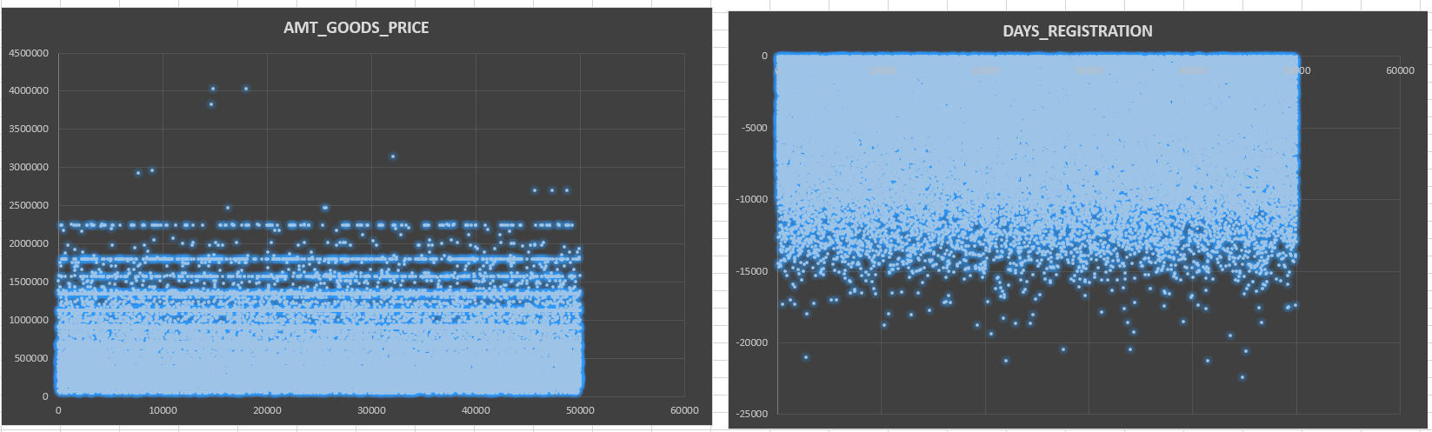
2) Identify Outliers in the Dataset:
DATA ANALYSIS
Results:

Slide 14
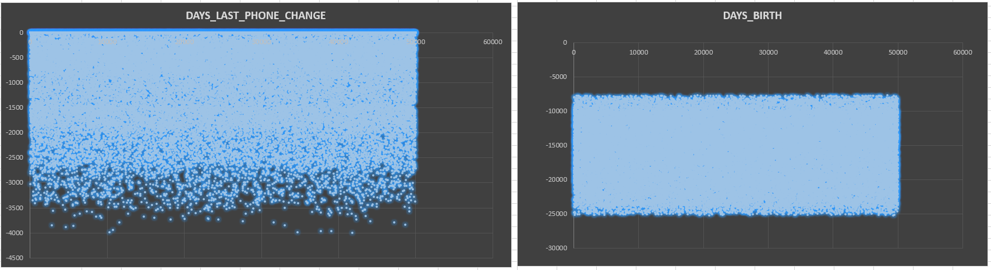
2) Identify Outliers in the Dataset:
DATA ANALYSIS
Results:

Slide 15
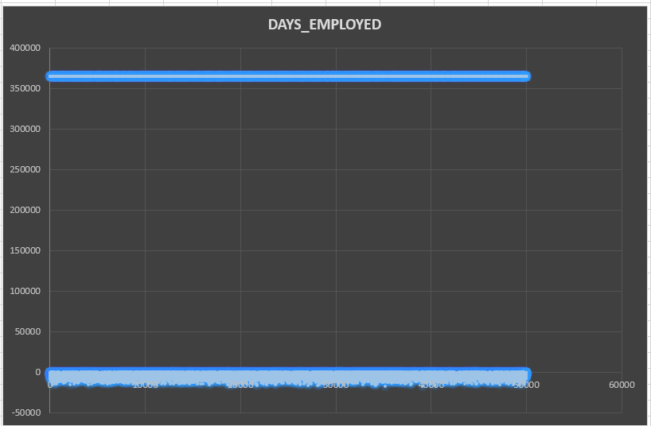
2) Identify Outliers in the Dataset:
DATA ANALYSIS
Results:

Slide 16
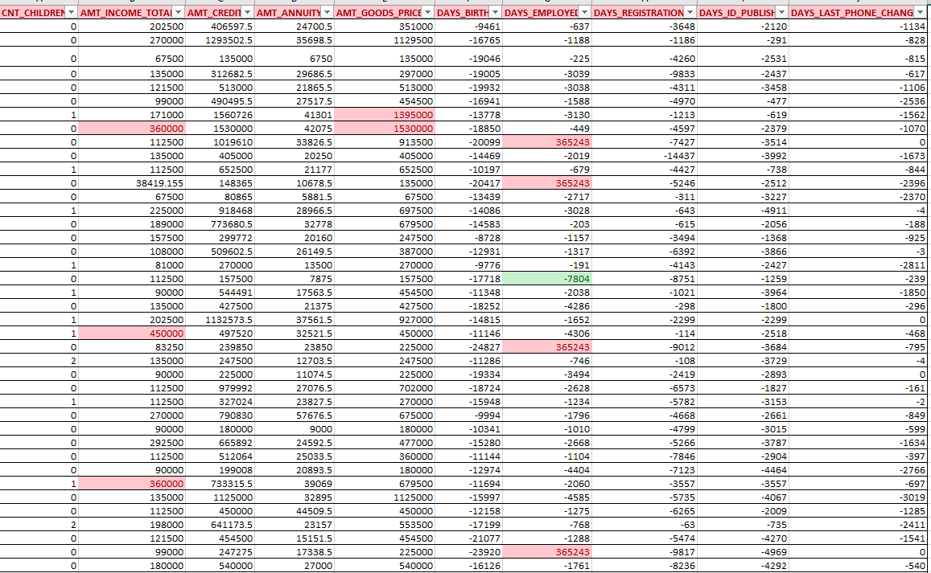
2) Identify Outliers in the Dataset:
DATA ANALYSIS
Results:
I have also highlighted the columns using conditional formatting of upper bound and lower bound

Slide 17
3) Analyse Data Imbalance:
DATA ANALYSIS
Data imbalance can affect the accuracy of the analysis, especially for binary
classification problems. Understanding the data distribution is crucial for building
reliable models.
Task: Determine if there is data imbalance in the loan application dataset and
calculate the ratio of data imbalance using Excel functions.
Functions that I have used:
LINK FOR THE PROJECT
=UNIQUE(B2:B50000)
=COUNTIF(B2:B50000,1) OR =COUNTIF(B2:B50000,0)
By using these functions, I have Calculated count/occurrence of a particular scenario in a column.
I have also calculated the ratio of imbalance between these data.

Slide 18
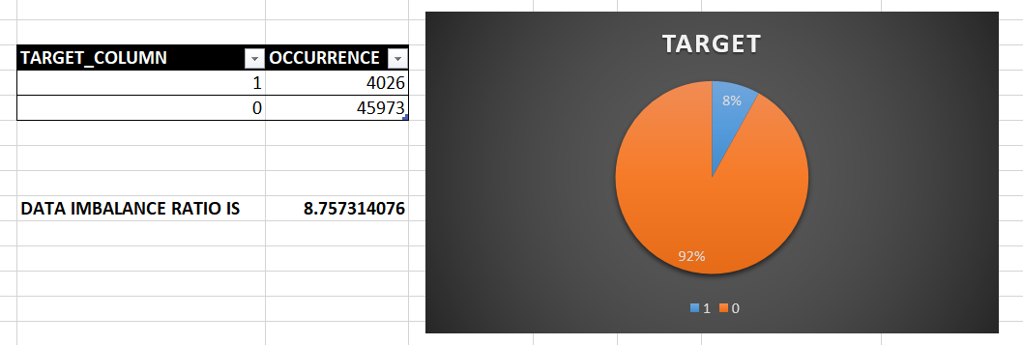
3) Analyse Data Imbalance:
DATA ANALYSIS
Results:

Slide 19
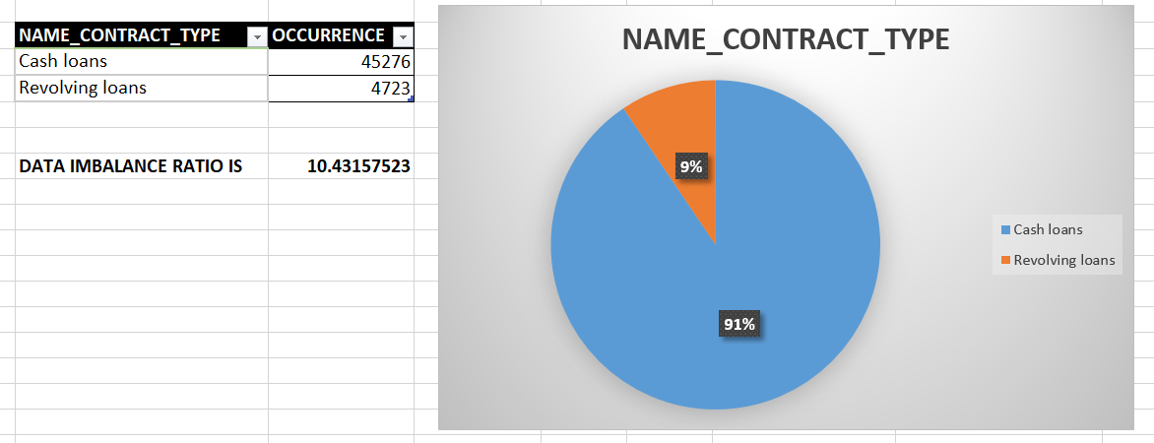
3) Analyse Data Imbalance:
DATA ANALYSIS
Results:

Slide 20
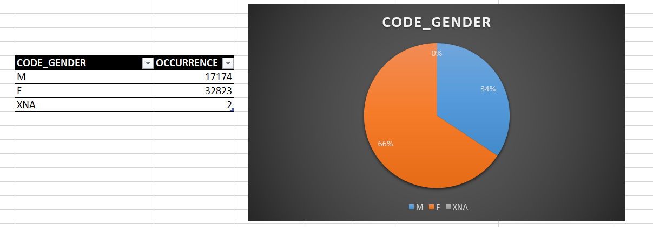
3) Analyse Data Imbalance:
DATA ANALYSIS
Results:

Slide 21
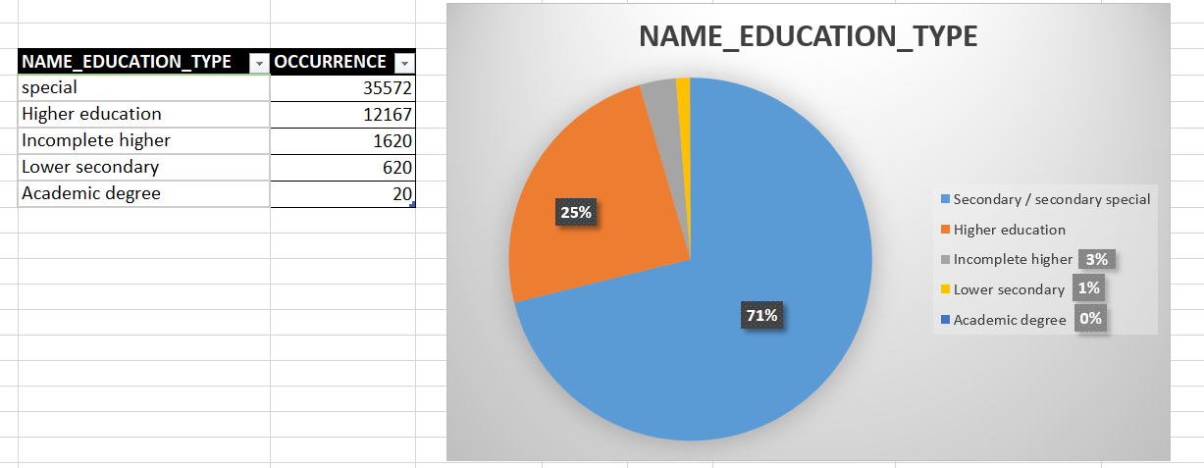
3) Analyse Data Imbalance:
DATA ANALYSIS
Results:

Slide 22
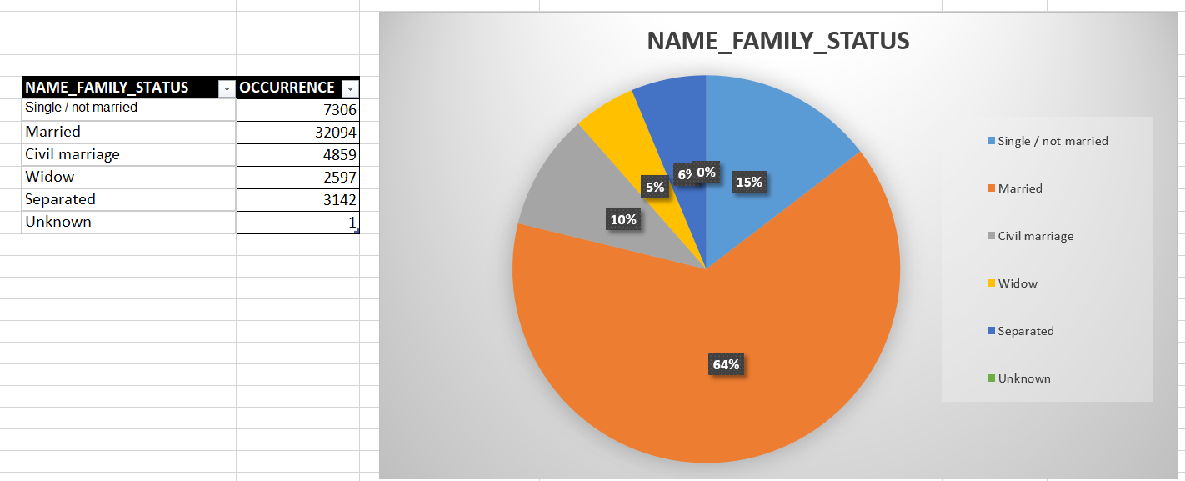
3) Analyse Data Imbalance:
DATA ANALYSIS
Results:

Slide 23
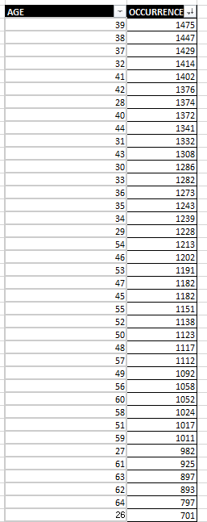
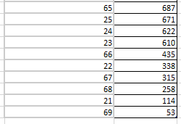
3) Analyse Data Imbalance:
DATA ANALYSIS
Results:

Slide 24
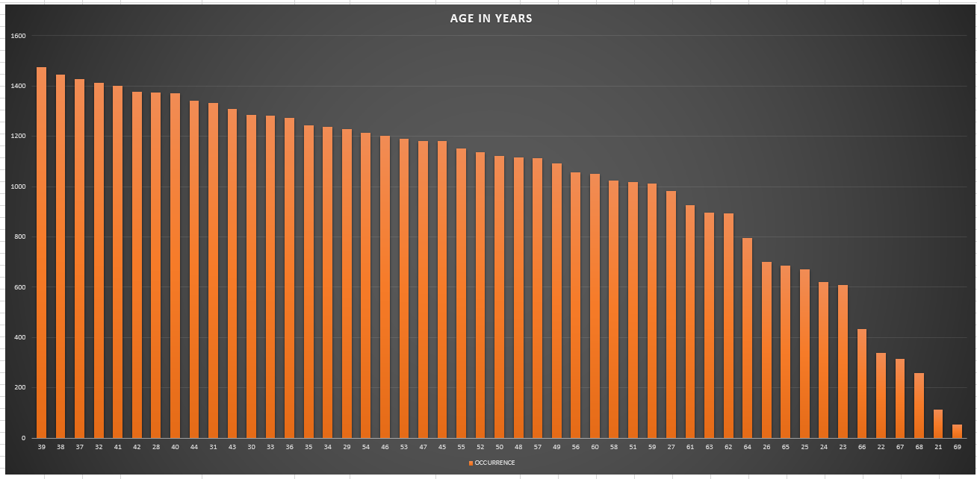
3) Analyse Data Imbalance:
DATA ANALYSIS
Results:

Slide 25
4) Perform Univariate, Segmented Univariate and Bivariate Analysis:
DATA ANALYSIS
To gain insights into the driving factors of loan default, it is important to conduct
various analyses on consumer and loan attributes.
Task: Perform univariate analysis to understand the distribution of individual
variables, segmented univariate analysis to compare variable distributions for
different scenarios, and bivariate analysis to explore relationships between variables
and the target variable using Excel functions and features.
Functions that I have used:
LINK FOR THE PROJECT
I have created pivot tables using appropriate columns.
Then used count function in pivot table to count occurrence them.
Then plotted using Histogram.

Slide 26
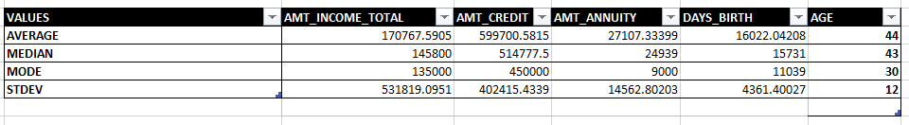
4) Perform Univariate, Segmented Univariate and Bivariate Analysis:
DATA ANALYSIS
Results:

Slide 27
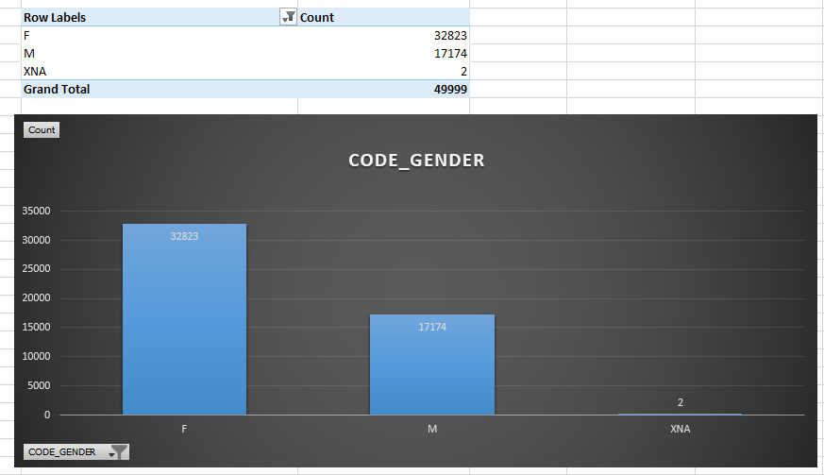
4) Perform Univariate, Segmented Univariate and Bivariate Analysis:
DATA ANALYSIS
Univariate Results:

Slide 28
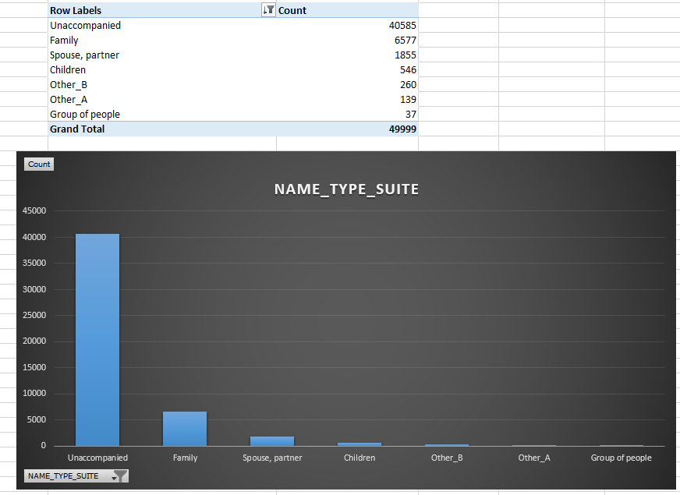
4) Perform Univariate, Segmented Univariate and Bivariate Analysis:
DATA ANALYSIS
Univariate Results:

Slide 29
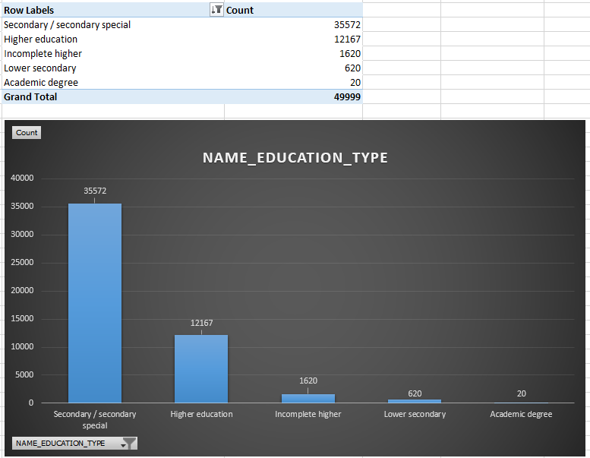
4) Perform Univariate, Segmented Univariate and Bivariate Analysis:
DATA ANALYSIS
Univariate Results:

Slide 30
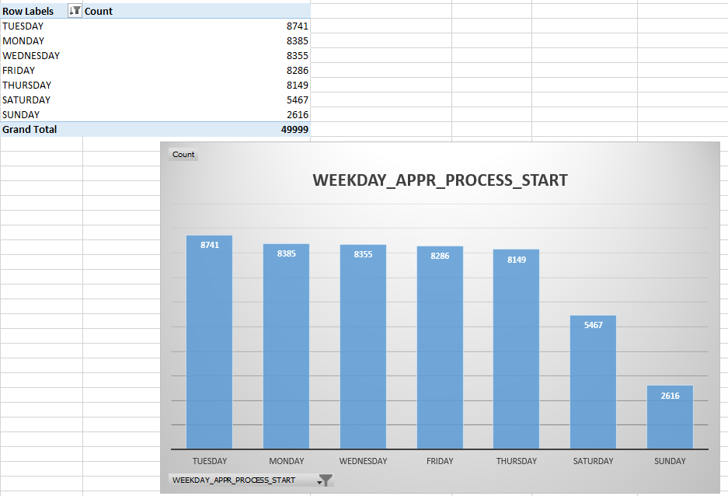
4) Perform Univariate, Segmented Univariate and Bivariate Analysis:
DATA ANALYSIS
Univariate Results:

Slide 31
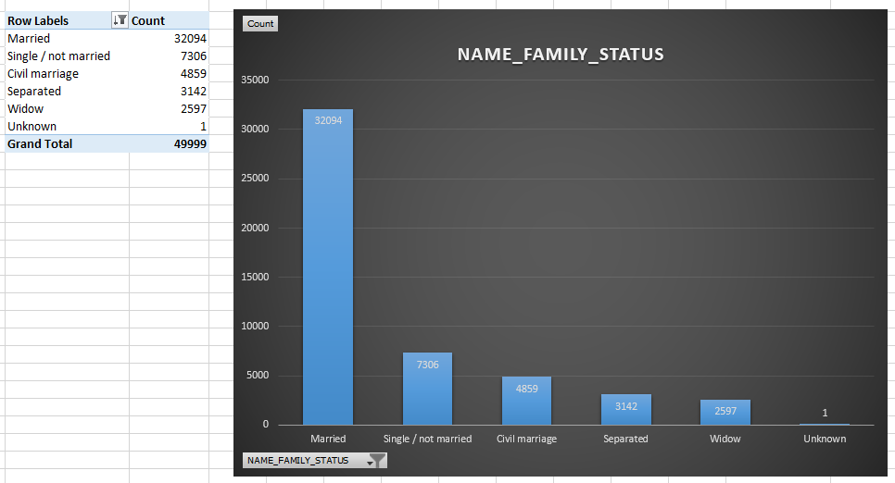
4) Perform Univariate, Segmented Univariate and Bivariate Analysis:
DATA ANALYSIS
Univariate Results:

Slide 32
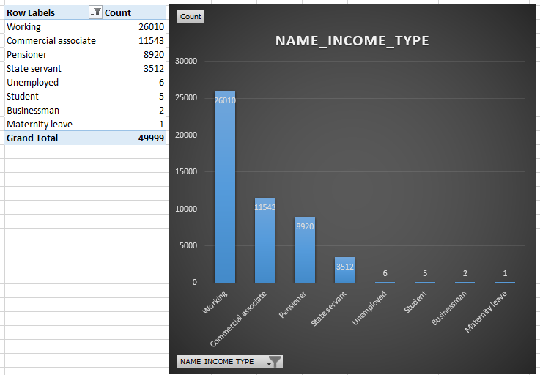
4) Perform Univariate, Segmented Univariate and Bivariate Analysis:
DATA ANALYSIS
Univariate Results:

Slide 33
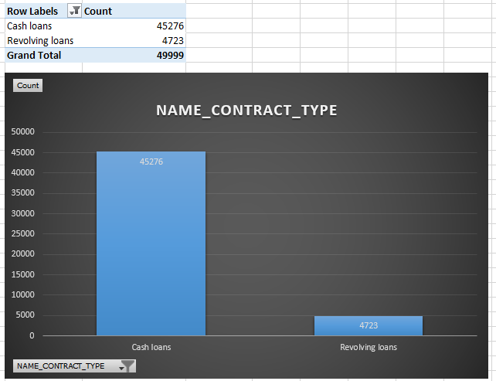
4) Perform Univariate, Segmented Univariate and Bivariate Analysis:
DATA ANALYSIS
Univariate Results:

Slide 34
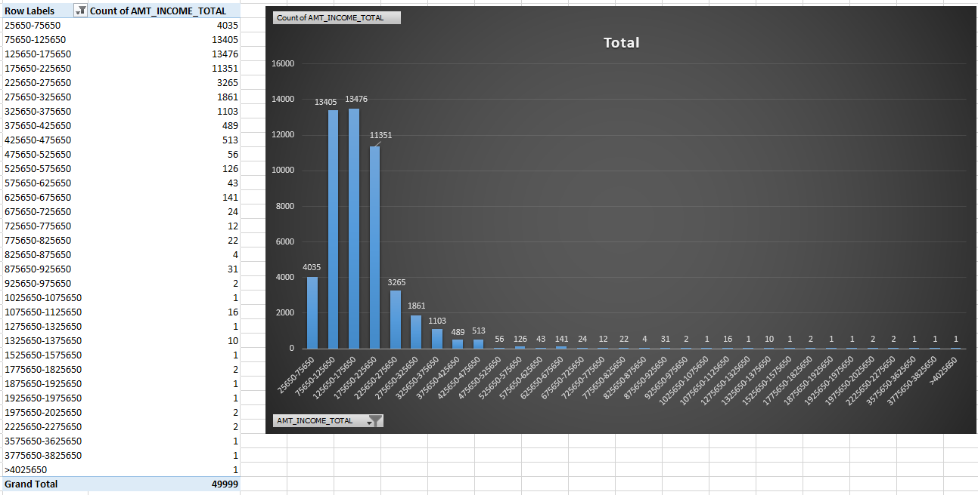
4) Perform Univariate, Segmented Univariate and Bivariate Analysis:
DATA ANALYSIS
Univariate Results:

Slide 35
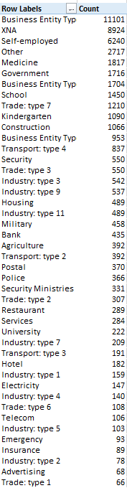
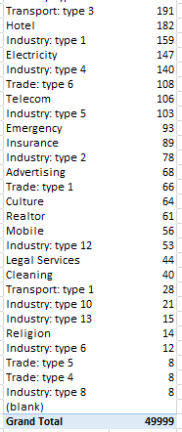
4) Perform Univariate, Segmented Univariate and Bivariate Analysis:
DATA ANALYSIS
Univariate Results:

Slide 36
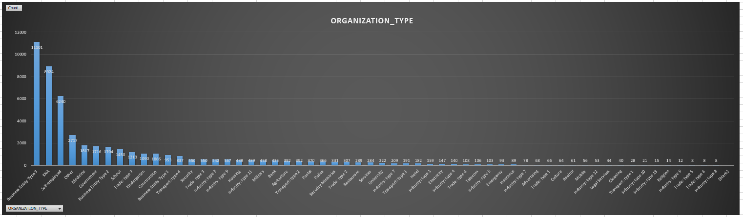
4) Perform Univariate, Segmented Univariate and Bivariate Analysis:
DATA ANALYSIS
Univariate Results:

Slide 37
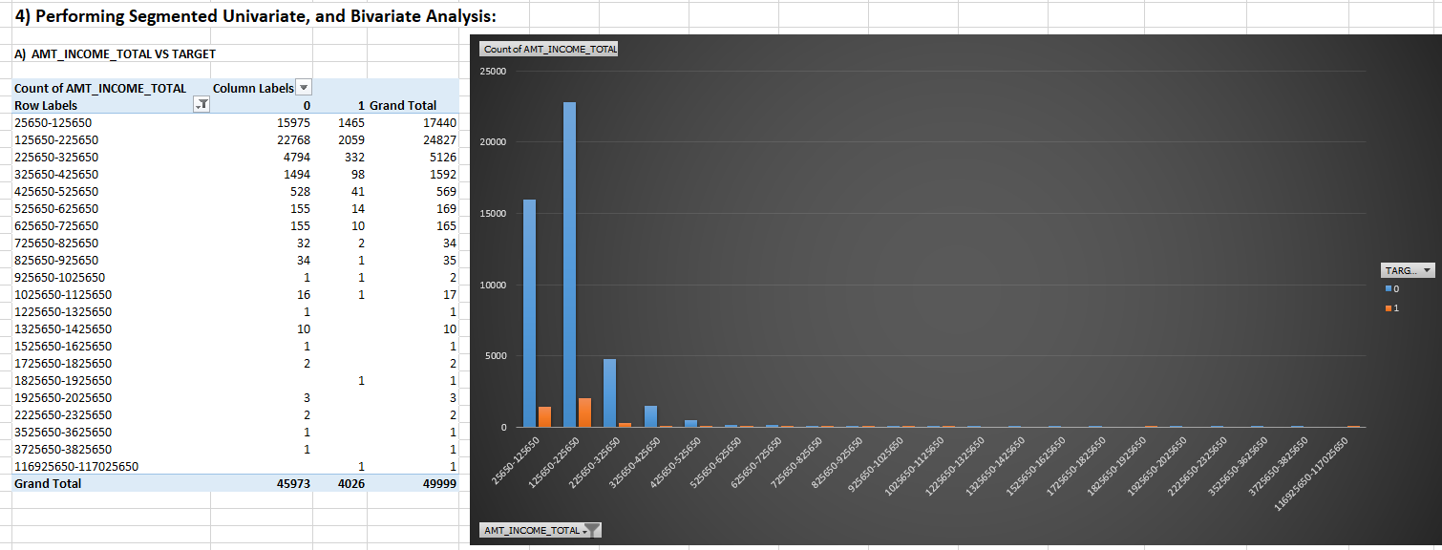
4) Perform Univariate, Segmented Univariate and Bivariate Analysis:
DATA ANALYSIS
Segment Univariate & Bivariate Results:

Slide 38
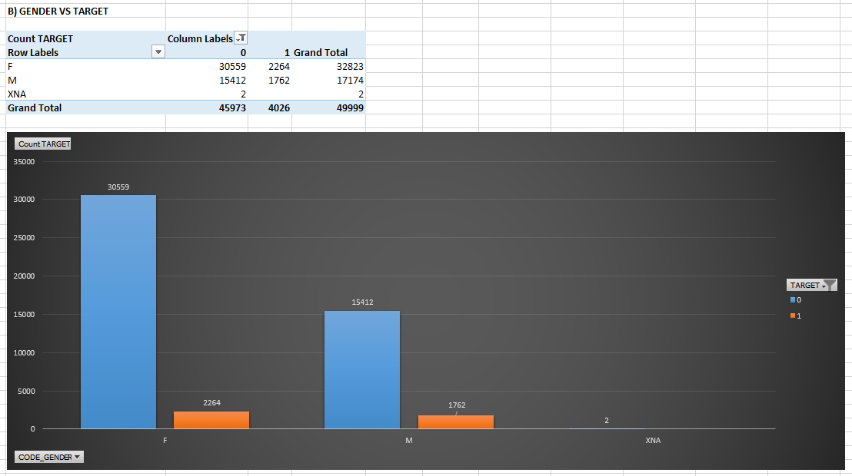
4) Perform Univariate, Segmented Univariate and Bivariate Analysis:
DATA ANALYSIS
Segment Univariate & Bivariate Results:

Slide 39
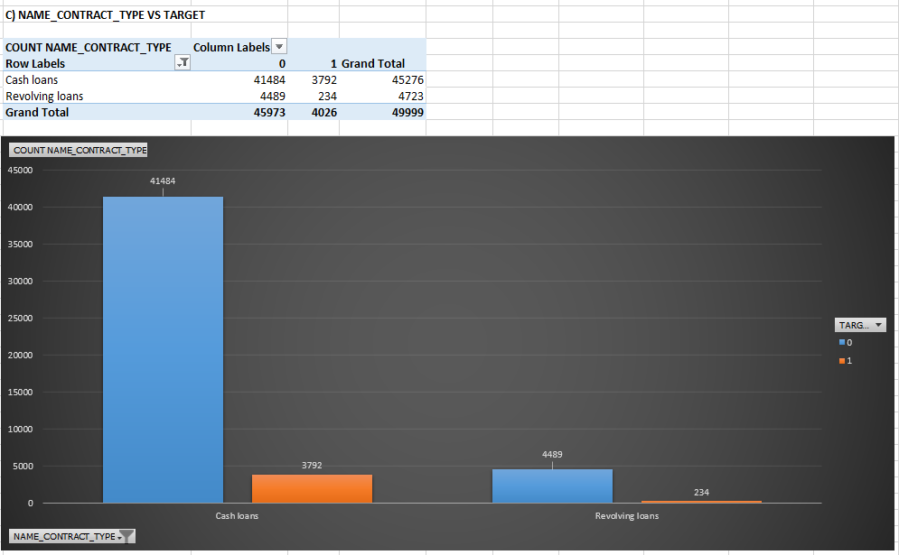
4) Perform Univariate, Segmented Univariate and Bivariate Analysis:
DATA ANALYSIS
Segment Univariate & Bivariate Results:

Slide 40
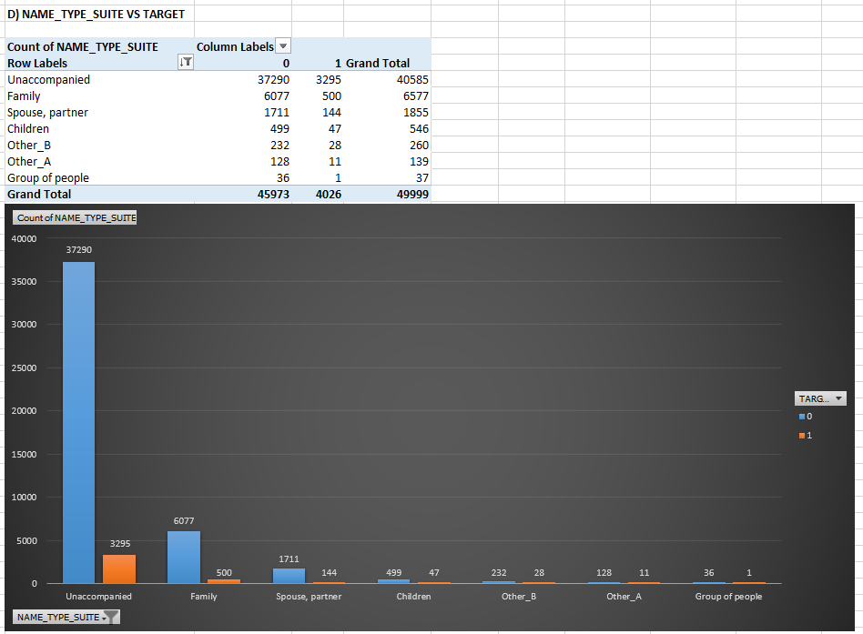
4) Perform Univariate, Segmented Univariate and Bivariate Analysis:
DATA ANALYSIS
Segment Univariate & Bivariate Results:

Slide 41
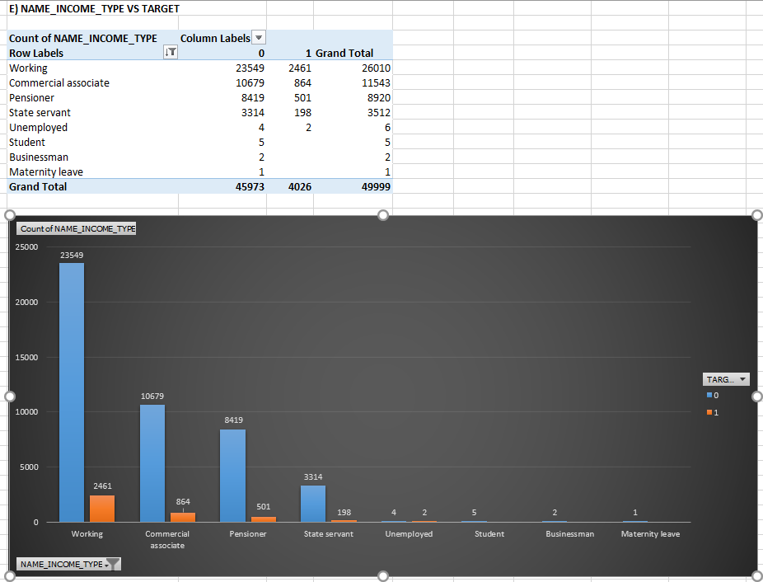
4) Perform Univariate, Segmented Univariate and Bivariate Analysis:
DATA ANALYSIS
Segment Univariate & Bivariate Results:

Slide 42
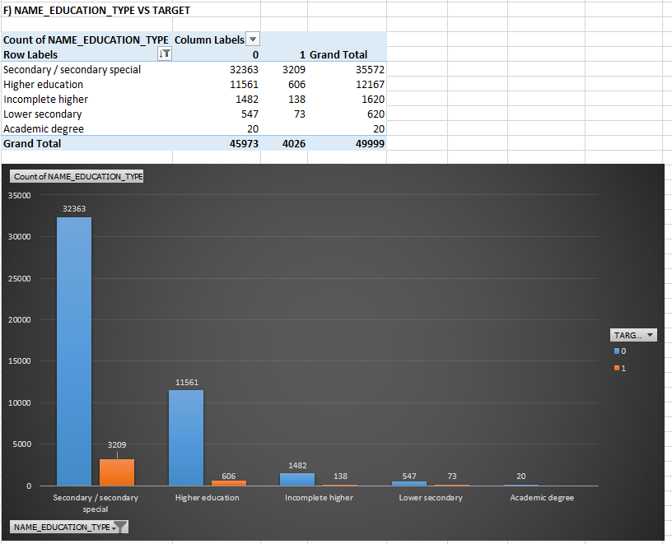
4) Perform Univariate, Segmented Univariate and Bivariate Analysis:
DATA ANALYSIS
Segment Univariate & Bivariate Results:

Slide 43
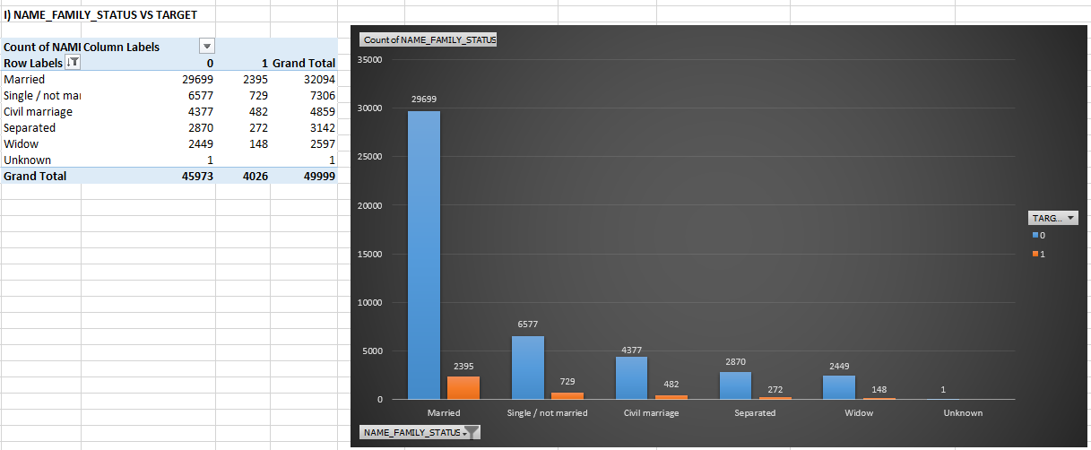
4) Perform Univariate, Segmented Univariate and Bivariate Analysis:
DATA ANALYSIS
Segment Univariate & Bivariate Results:

Slide 44
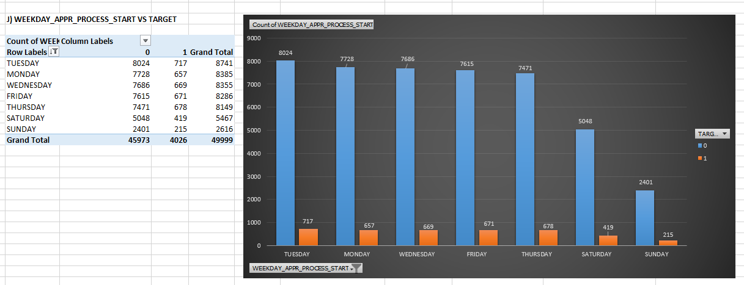
4) Perform Univariate, Segmented Univariate and Bivariate Analysis:
DATA ANALYSIS
Segment Univariate & Bivariate Results:

Slide 45
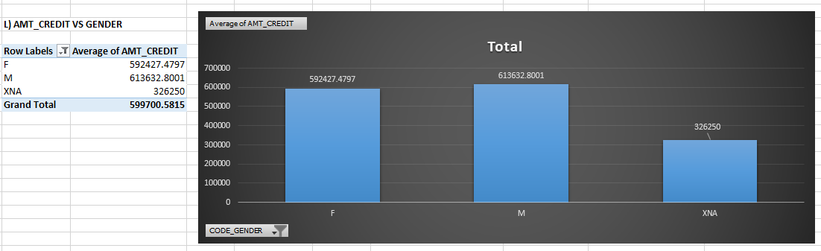
4) Perform Univariate, Segmented Univariate and Bivariate Analysis:
DATA ANALYSIS
Segment Univariate & Bivariate Results:

Slide 46
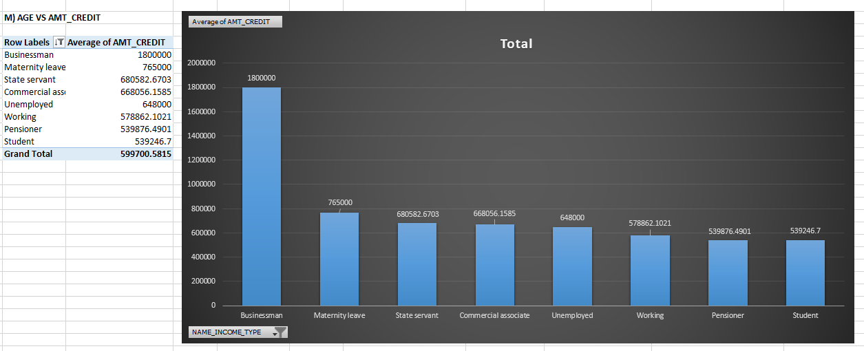
4) Perform Univariate, Segmented Univariate and Bivariate Analysis:
DATA ANALYSIS
Segment Univariate & Bivariate Results:

Slide 47
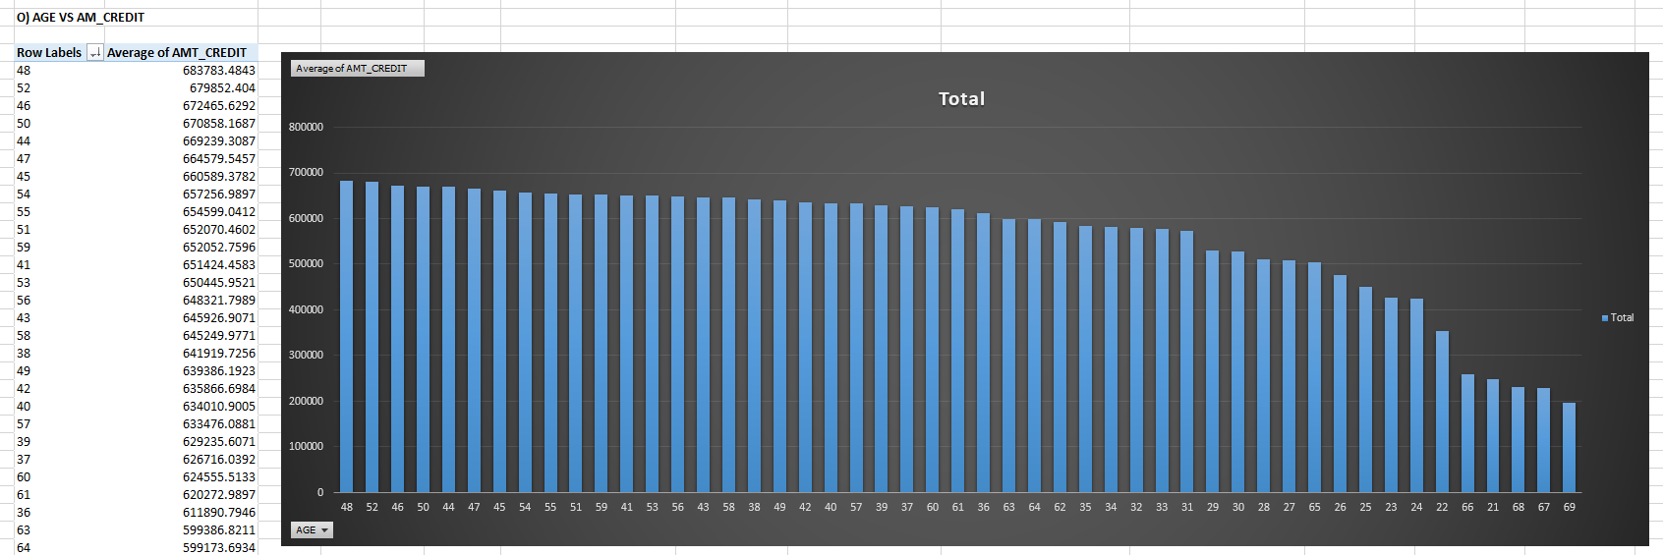
4) Perform Univariate, Segmented Univariate and Bivariate Analysis:
DATA ANALYSIS
Segment Univariate & Bivariate Results:

Slide 48
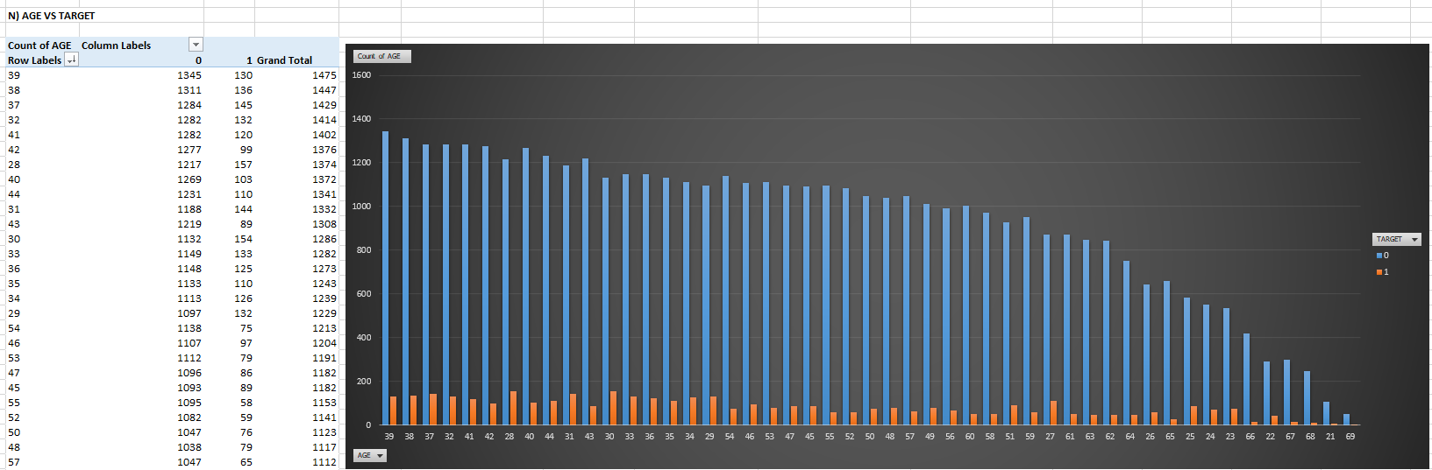
4) Perform Univariate, Segmented Univariate and Bivariate Analysis:
DATA ANALYSIS
Segment Univariate & Bivariate Results:

Slide 49
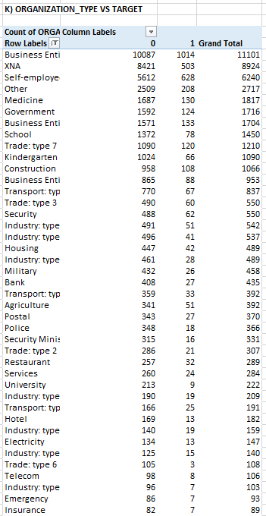
4) Perform Univariate, Segmented Univariate and Bivariate Analysis:
DATA ANALYSIS
Segment Univariate & Bivariate Results:

Slide 50

4) Perform Univariate, Segmented Univariate and Bivariate Analysis:
DATA ANALYSIS
Segment Univariate & Bivariate Results:

Slide 51
5) Identify Top Correlations for different scenarios:
DATA ANALYSIS
Understanding the correlation between variables and the target variable can
provide insights into strong indicators of loan default.
Task: Segment the dataset based on different scenarios (e.g., clients with
payment difficulties and all other cases) and identify the top correlations for
each segmented data using Excel functions.
Functions that I have used:
First, I found correlation between target and various columns by using following function:
=CORREL(D2:D50000,C2:C50000)
https://docs.google.com/spreadsheets/d/1zyX-hMR5zvB5rdqSWwr8bC69_EDzqUQW/edit?usp=sharing&ouid=113249253121491889461&rtpof=true&sd=true

Slide 52



5) Identify Top Correlations for different scenarios:
DATA ANALYSIS
Results:

Slide 53


5) Identify Top Correlations for different scenarios:
DATA ANALYSIS
Results:

Slide 54


5) Identify Top Correlations for different scenarios:
DATA ANALYSIS
Results:

Slide 55
Insights
There are many missing values in the dataset. The columns having null values above 25% are deleted and the missing values are replaced using median and mode.
There are many outliers in the dataset. We can use appropriate methods to deal with outliers.
There is a data imbalance in most of the columns.
People who has low income, Married, Working and has age 38-39 years have taken the loan mostly and also they are most likely to default the loan.
There are many correlations between the columns and the highest correlated column is DAYS_BIRTH.

Slide 56
Conclusion
Finally, I have successfully completed this project using Excel, Power point. I have learned to deal with large datasets which has many missing values and outliers.
Thank You

